Slide 1
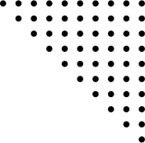
Support Vector Machine (SVM)
Dr. Prasenjit Dey
Contact details:-
9123363688
deyp@nitrkl.ac.in

Slide 2
CONTENT
Vapnik-Chervonenkis theory
Structural Risk Minimization
Support Vector Machine(SVM)
Types of SVM
How SVM work
Non-linear data mapping
Kernel trick
Types of Kernel Function
Advantages
Disadvantages

Slide 3
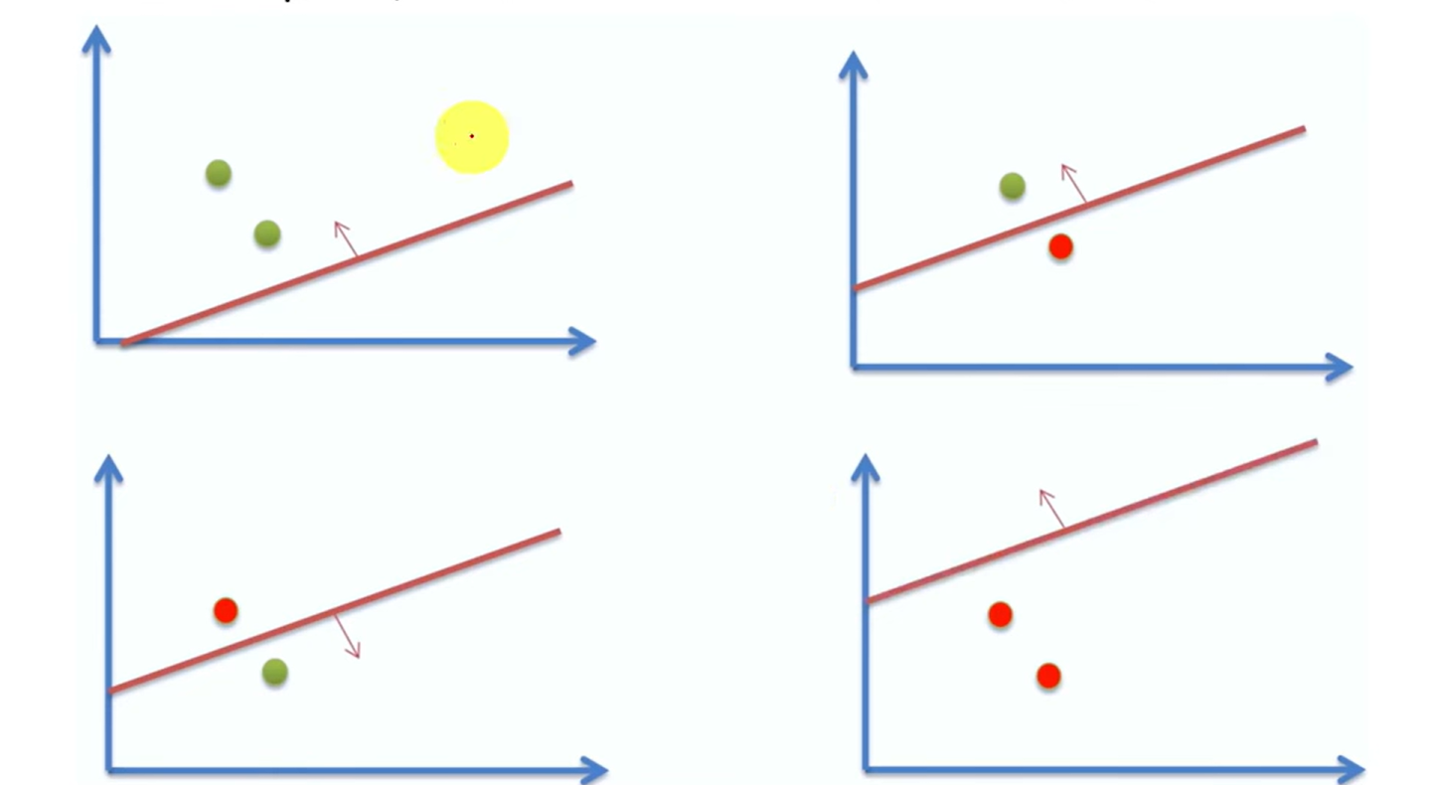

Vapnik-Chervonenkis Theory
It helps us understand the capacity of a hypothesis class used by a machine learning model to classify data points.
It measures this capacity using the VC dimension, which is the maximum number of data points a model can shatter (i.e., classify correctly in all possible ways)
If there is n data point, then there are 2^{n} different ways to classify them
A model can shatter 2 points if it can correctly classify them in 4(=2²) possible ways

Slide 4
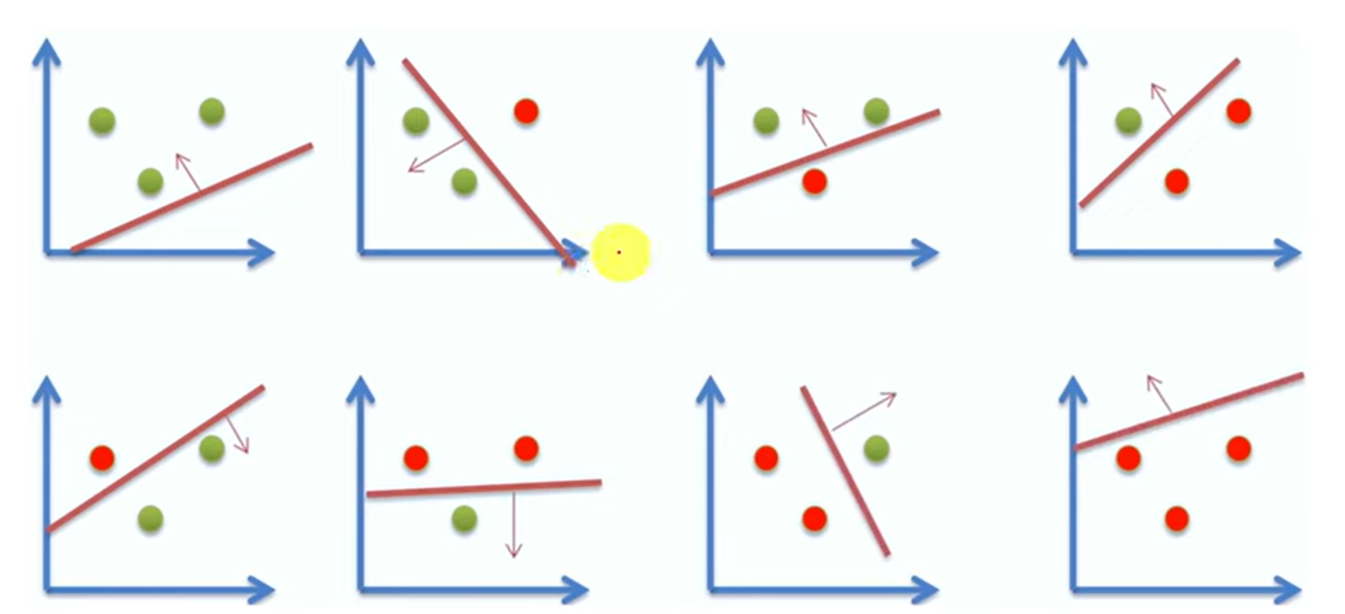
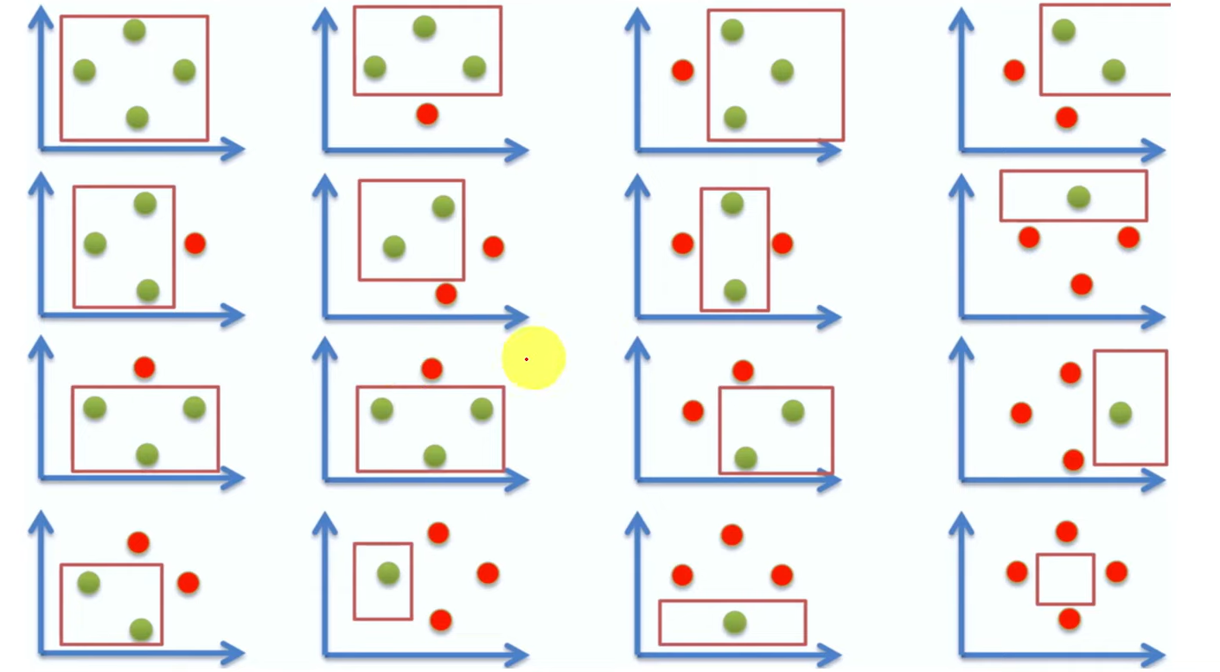
3 Data Points:
A model can shatter 3 points if it can correctly classify them in all 8 possible labelings.
4 Data Points:
A model can shatter 4 points if it can correctly classify them in all 16 possible labelings.
A line can't divide them correctly because each side will always have mixed points.
However, a square boundary can separate them perfectly by enclosing one class inside and keeping the other outside
The Maximum number of data points that can be shattered by square in 2-Dimensional space is 4

Slide 5
Drawbacks of VC Theory
Complexity: Understanding and calculating the VC dimension can be mathematically complex.
Practical Limits: A high VC dimension indicates high model capacity, which can lead to overfitting when the training data size is insufficient.
Real-World Use: In practice, we balance VC dimension with other factors like data size and noise.
Practical Use
Model Complexity: A lower VC dimension indicates a less complex model, reducing the risk of overfitting.
Training Data: More training data leads to better generalization by reducing the gap between empirical risk(error rate on the training data) and true risk(error rate on the new/unseen data data).

Slide 6

Structural Risk Minimization (SRM)
SRM is a principle in ML aimed at finding a balance between a model's complexity and its performance on training data to achieve good generalization on new data.
Empirical Risk: The error rate on the training data
Model Complexity: How complicated the model is, often characterized theoretically by VC dimension (and approximated in practice by model size or regularization)
True Risk: The expected error rate on new, unseen data
True Risk Estimate ≤ Empirical Risk + Complexity Penalty

Slide 7
Support Vector Machines
Supervised machine learning algorithm used for both classification and regression
The objective of the SVM algorithm is to find an optimal hyperplane in an n-dimensional space that can separate the data points in different classes in the feature space.
The hyperplane tries aims to maximize the margin between the closest points of different classes.
The dimension of the hyperplane depends upon the number of features.

Slide 8
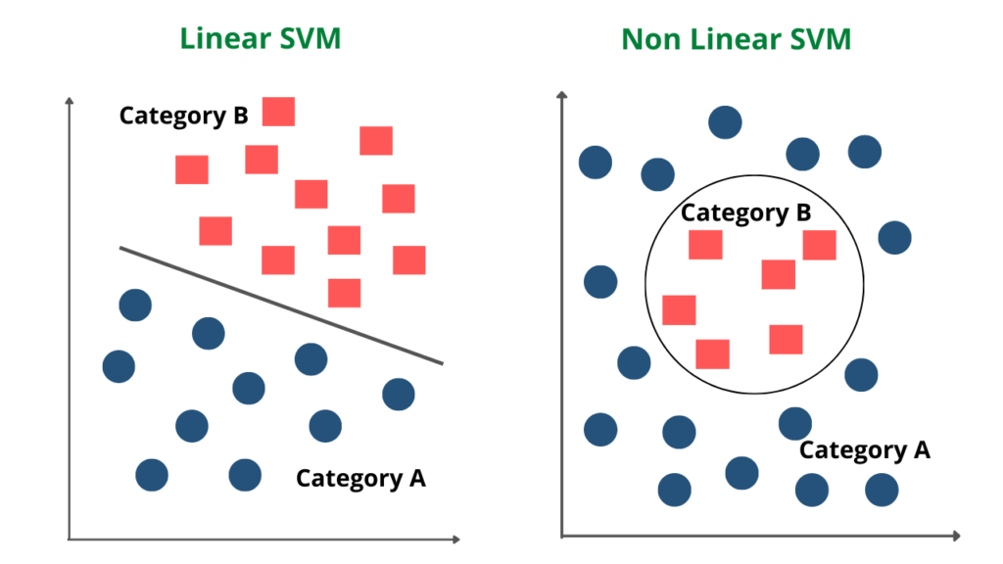
Types of SVM
Linear SVM: Linear SVM is used for linearly separable data, which means if a dataset can be classified into two classes by using a Hyperplane.
Non-linear SVM: Non-Linear SVM is used for non-linearly separated data, which means if a dataset cannot be classified by using a Hyperplane.

Slide 9
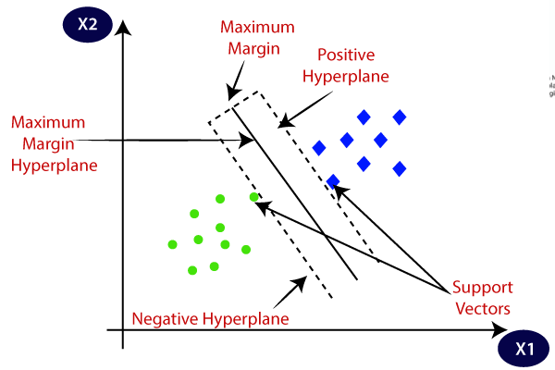
Support Vector Machine (SVM)
SVM is an approximate implementation of SRM
Maximizing distance of the decision boundary from training points minimizes the VC dimension resulting into the Good generalization.
Target is Maximizing distance between decision boundary and the training points
The margin is the distance between the hyperplane and the closest points from either class. SVM aims to maximize this margin, leading to a more robust classifier.
Support Vectors: These are the data points that lie closest to the hyperplane. The position of these points is critical as they directly influence the position and orientation of the hyperplane.

Slide 10
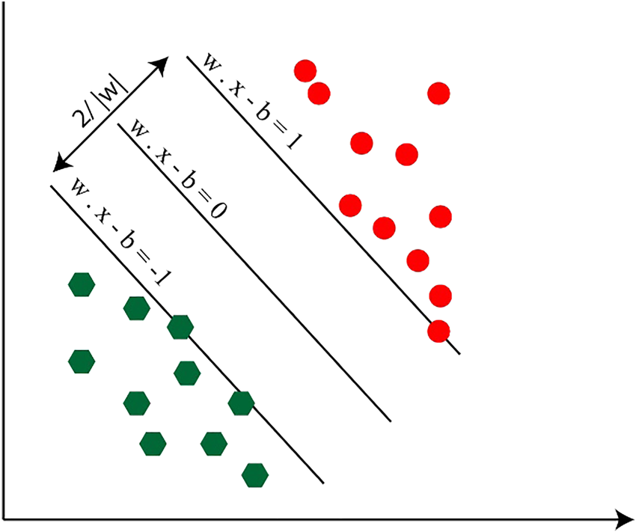
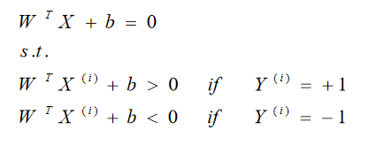
SVM
It separates data into two classes: +1 (positive) and -1 (negative). It uses a linear boundary, or hyperplane, to divide the classes.
The goal is to find a hyperplane that maximizes the margin between the closest points of each class. This is called a maximum margin classifier or hard margin SVM.
We have data set {X^{(i)},Y^{(i)}} i =1,...., m, XϵR^{d} and y(i)∈{−1,+1}
separating hyperplane

Slide 11
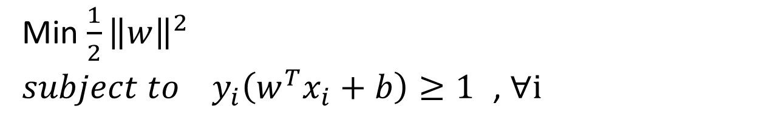
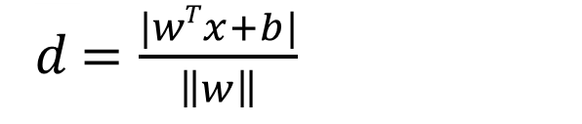
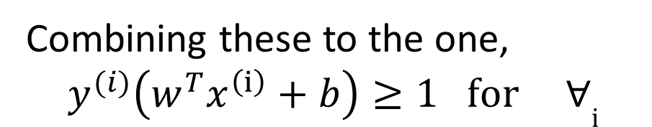
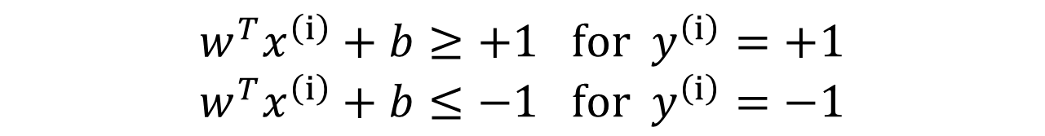

Suppose training data satisfy following constrains also,
$${w^{T}x}^{\left(ⅈ\right)}+b≥+1 for { y}^{\left(ⅈ\right)}=+1$$
$${w^{T}x}^{\left(ⅈ\right)}+b≤−1 for { y}^{\left(ⅈ\right)}=−1$$
Combining these to the one,
$$y^{(i)}\left(w^{T}x^{\left(ⅈ\right)}+b\right)≥1 for ∀ⅈ$$
The objective is to find Hyperplane (w, b) with maximal separation between it and closest data
points while satisfying the above constraints
The Maximum Margin Hyperplane
The perpendicular distance 𝑑 of a data point 𝑥 from the margin is given by:
𝑑 $=\frac{|wTx+b|}{\left\|w\right\|}$
$$\left\|w\right\|=\sqrt{w^{T}w}$$
To maximize this distance, we can minimize the square of the denominator to give us a quadratic programming problem given by:
Min $\frac{1}{2}{\left\|w\right\|}^{2 }$
$subject to y_{i}\left(w^{T}x_{i}+b\right)≥1$ , $∀i$

Slide 12
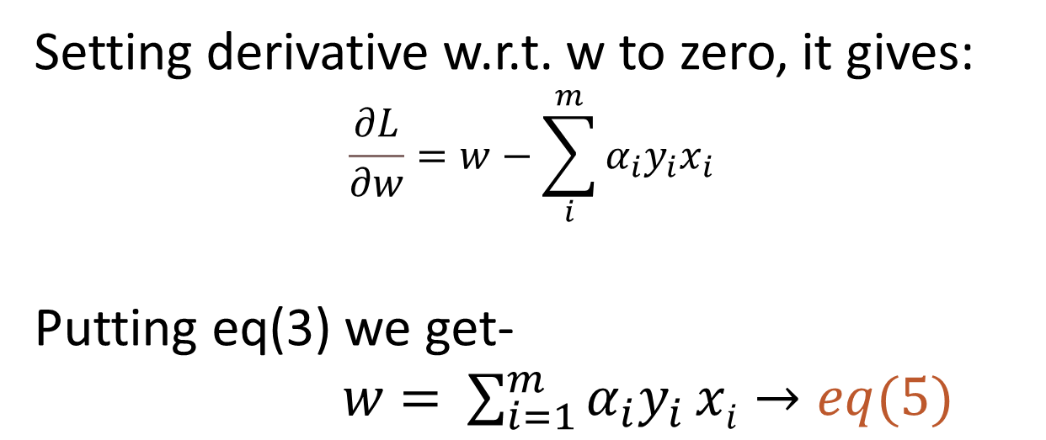
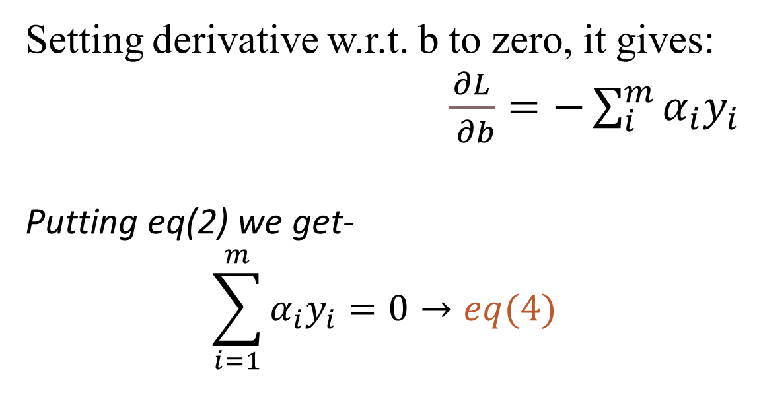
Solution Via The Method Of Lagrange Multipliers
To solve the above quadratic programming problem with inequality constraints, we can use the method of Lagrange multipliers L(w,b,$α$)
L(w,b,$α$)=$\frac{1}{2}{\left\|w\right\|}^{2}−\sum_{i}^{m}{α_{i}\left(y_{i}\left(w{Tx}_{i}+b\right)−1\right)}→eq\left(1\right)$
$${where α}_{i}=Langrange Multiplier$$
Now minimizing eq(1) w.r.t. w and b:
We set derivatives of Lagrangian w.r.t. w and b to zero $\frac{∂L}{∂w}=0→eq\left(2\right), \frac{∂L}{∂b}=0→eq\left(3\right)$
Setting derivative w.r.t. b to zero, it gives:
$\frac{∂L}{ ∂b}=−\sum_{i}^{m}{α_{i}y_{i}}$
Putting eq(2) we get-
$$\sum_{i=1}^{m}{α_{i}y_{i}}=0→eq(4)$$
Setting derivative w.r.t. w to zero, it gives:
$$\frac{∂L}{∂w}=w−\sum_{i}^{m}{α_{i}y_{i}x_{i}}$$
Putting eq(3) we get-
$w=$ $\sum_{i=1}^{m}{α_{i}y_{i}}xi→eq(5)$

Slide 13
Expanding Eq(1) we get-
L(w,b,$α$)=$\frac{1}{2}\left(wT.w\right)−\sum{α_{i}y_{i}(w.x_{i}})−\sum{α_{i}y_{i}b}+\sum{α_{i}→eq\left(6\right)}$
Putting eq(5) in eq(6)
L(b,$α$)= $\sum_{i=1}^{m}{α_{i}}−\frac{1}{2}\sum_{i,j=1}^{m}{α_{i}{α_{j}y}_{i}y_{j}{(x}_{i}.x_{j})−b\sum{α_{i}y_{i}}→eq\left(7\right)}$
Putting eq(4) in eq(7)
L($α$)= $\sum_{i=1}^{m}{α_{i}}−\frac{1}{2}\sum_{i,j=1}^{m}{α_{i}{α_{j}y}_{i}y_{j}{(x}_{i}.x_{j})}$

Slide 14
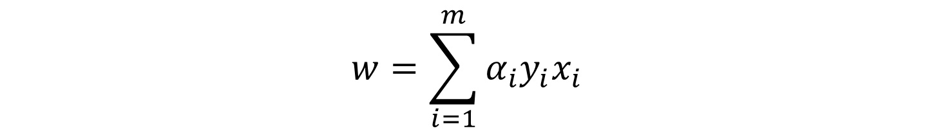
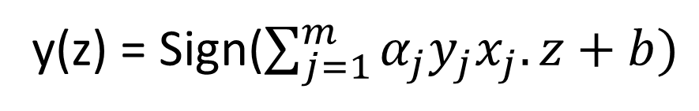
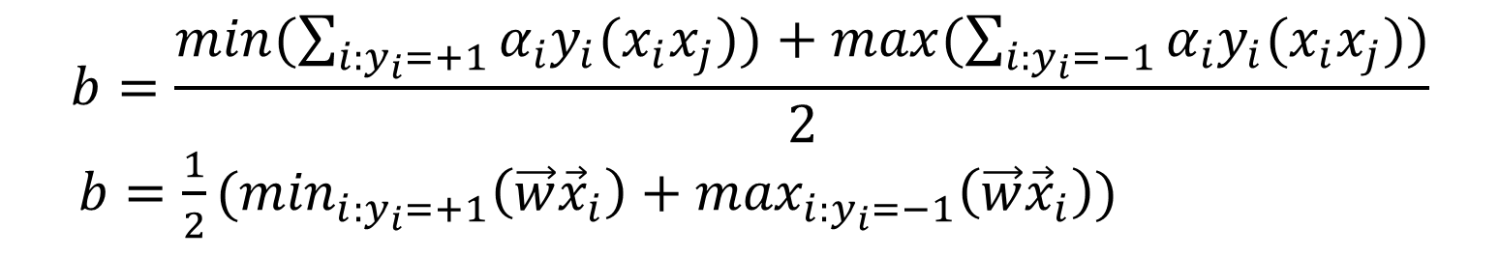
Values of W and b
Optimized value of w and b:
$$w=\sum_{i=1}^{m}{α_{i}y_{i}x_{i}}$$
$$b=\frac{min⁡(\sum_{i:y_{i}=+1}{α_{i}y_{i}(x_{i}x_{j}}))+max⁡(\sum_{i:y_{i}=−1}{α_{i}y_{i}(x_{i}x_{j}}))}{2}$$
$b=\frac{1}{2}(\min_{i:y_{i}=+1}\left(\vec{w}{\vec{x}}_{i}\right)+$ $\max_{i:y_{i}=−1}\left(\vec{w}{\vec{x}}_{i}\right)$)
Classification of new Test Point
The classification of any test point z can be determined using this expression
y(z) = Sign($\sum_{j=1}^{m}{α_{j}y_{j}x_{j}.z+b)}$
A positive value of y(z) implies z$∈ +1 and a negative value means \text{z} ∈−1$

Slide 15
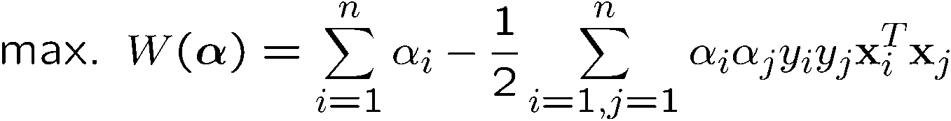
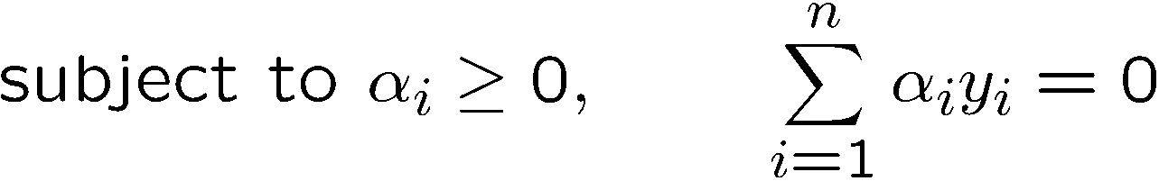
The Dual Problem
The new objective function is in terms of α_{i} only
It is known as the dual problem: if we know all α_{i}, we can recover w
The original problem is known as the primal problem
The objective function of the dual problem needs to be maximized (comes out from the KKT theory)
The dual problem is therefore:
Properties of α_{i} when we introduce the Lagrange multipliers
The result when we differentiate the original Lagrangian w.r.t. b

Slide 16
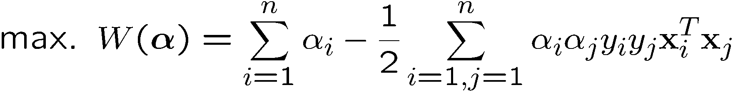
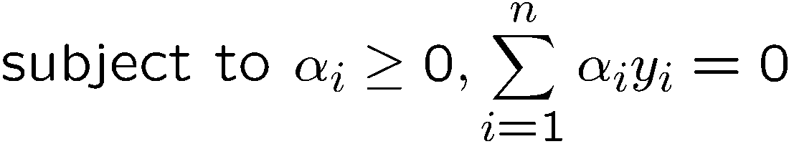
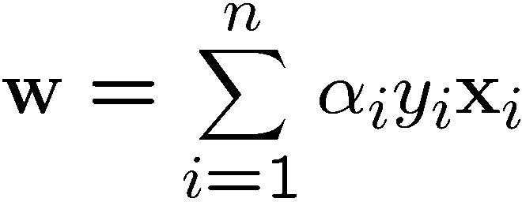
The Dual Problem
This is a quadratic programming (QP) problem
A global maximum of α_{i} can always be found
w can be recovered by
Notes:
Let x(1) and x(-1) be two S.V.
Then b = -1/2( w^T x(1) + w^T x(-1) )

Slide 17

Characteristics of the Solution
Many of the α_{i} are zero
w is a linear combination of a small number of data points
This “sparse” representation can be viewed as data compression as in the construction of kNN classifier
x_{i} with non-zero α_{i} are called support vectors (SV)
The decision boundary is determined only by the SV
Let t_{j} (j=1, ..., n) be the indices of the s support vectors. We can write
Note: w need not be formed explicitly
$$w=\sum_{j=1}^{n}{α_{j}y_{j}x_{j}}$$

Slide 18
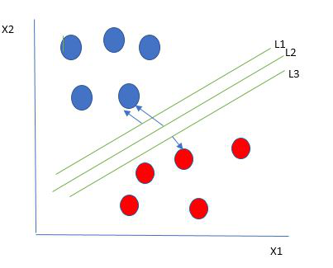
How does SVM work?
Which line will classify the unseen data well?
Therefore, we select the hyperplane that maximizes the margin between itself and the nearest data points from each class.

Slide 19
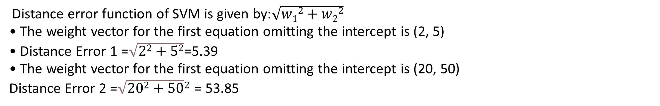
How to Select Best Hyperplane
The goal is to choose the hyperplane with the largest margin
Here’s how it works with the given example:
Hyperplane for classifier 1 = 5 + 2x₁ + 5x₂
Hyperplane for classifier 2 = 5 + 20x₁ + 50x₂
Calculate the Weight Vector:
For the first hyperplane: The weight vector is (2,5)
For the second hyperplane: The weight vector is (20,50)
2.Compute the Distance Error
Distance error function of SVM is given by:$\sqrt{w12+w22}$
• The weight vector for the first equation omitting the intercept is (2, 5)
• Distance Error 1 =$\sqrt{22+52}$=5.39
• The weight vector for the first equation omitting the intercept is (20, 50)
Distance Error 2 =$\sqrt{202+50}2$ = 53.85

Slide 20
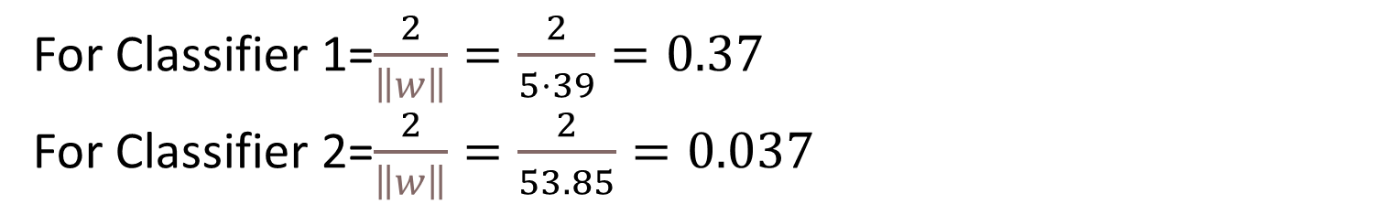
Calculate the Margin:
The margin is inversely proportional to the norm of the weight vector. It is calculated as 2/∥w∥.
For Classifier 1=$\frac{2}{\left\|w\right\|}=\frac{2}{5⋅39}=0.37$
For Classifier 2=$\frac{2}{\left\|w\right\|}=\frac{2}{53.85}=0.037$
Select the Hyperplane with the Larger Margin:
Compare the margins:
Classifier 1: Margin ≈ 0.37
Classifier 2: Margin ≈ 0.037
Classifier 1 has a larger margin
Classifier 1 is selected because it has a larger margin (0.37) compared to Classifier 2 (0.037)
A larger margin means better separation between classes and better generalization to new data

Slide 21
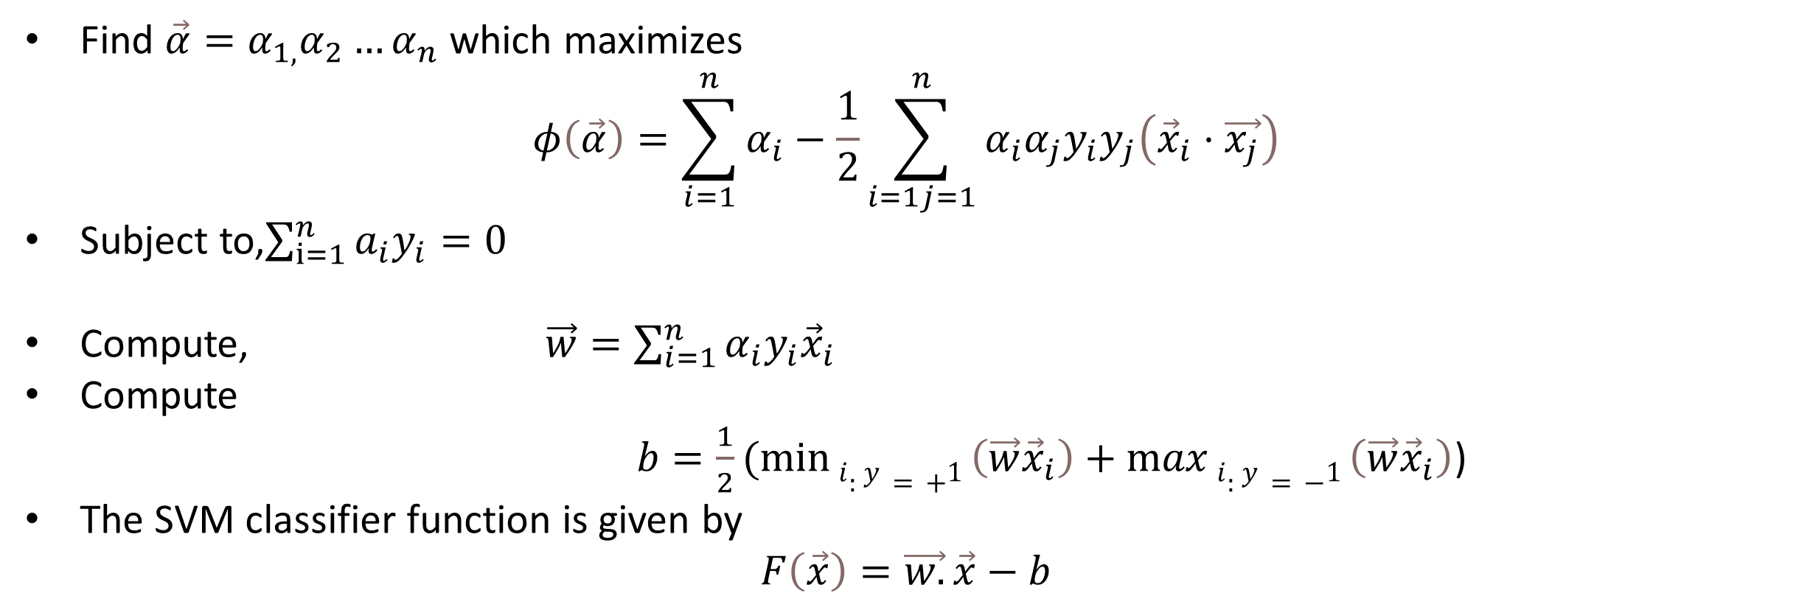
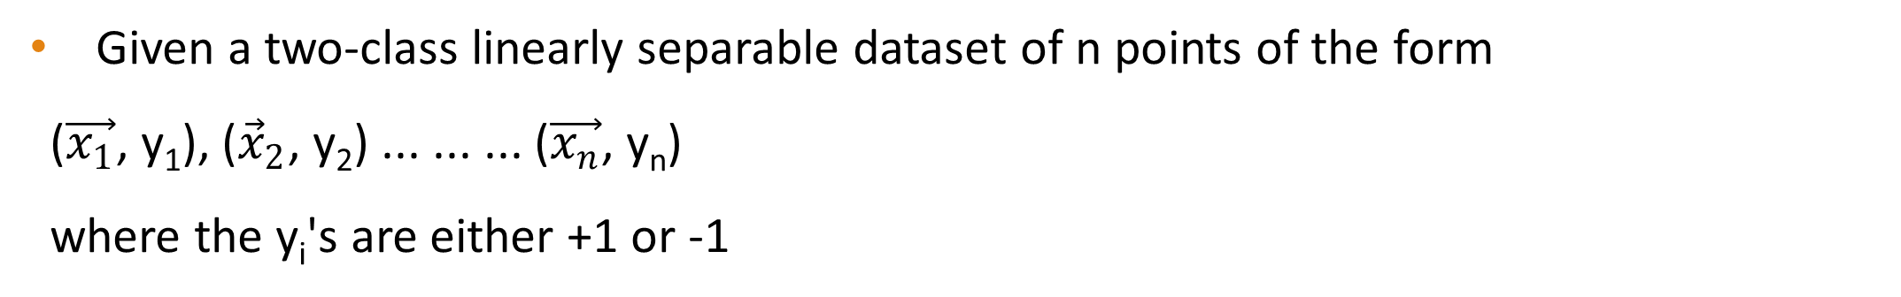
SVM Classifier Algorithm
Given a two-class linearly separable dataset of n points of the form
($\vec{x_{1}}$, y₁), (${\vec{x}}_{2}$, y₂) ... ... ... ($\vec{x_{n}}$, y_{n})
where the y_{i}'s are either +1 or -1
Find $\vec{α}=α_{1,}α_{2}…α_{n}$ which maximizes
$$φ\left(\vec{α}\right)=\sum_{i=1}^{n}{α_{i}}−\frac{1}{2}\sum_{i=1j=1}^{n}{α_{i}α_{j}y_{i}y_{j}\left({\vec{x}}_{i}⋅\vec{x_{j}}\right)}$$
Subject to,$\sum_{ⅈ=1}^{n}{a_{i}y_{i}}=0$
Compute, $\vec{w}=\sum_{i=1}^{n}{α_{i}y_{i}{\vec{x}}_{i}}$
Compute
$b=\frac{1}{2}(min{i:y=+1}\left(\vec{w}{\vec{x}}_{i}\right)+$ $\max{i:y=−1}\left(\vec{w}{\vec{x}}_{i}\right)$)
The SVM classifier function is given by
$$F\left(\vec{x}\right)=\vec{w.}\vec{x}−b$$

Slide 22
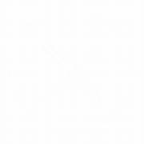
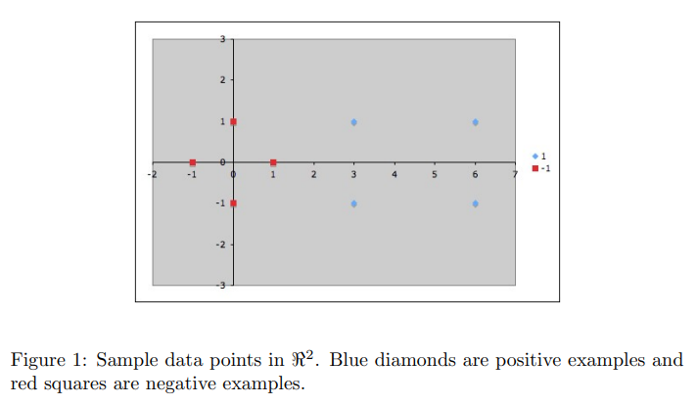
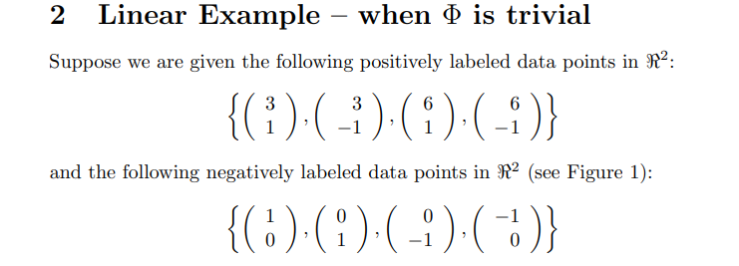

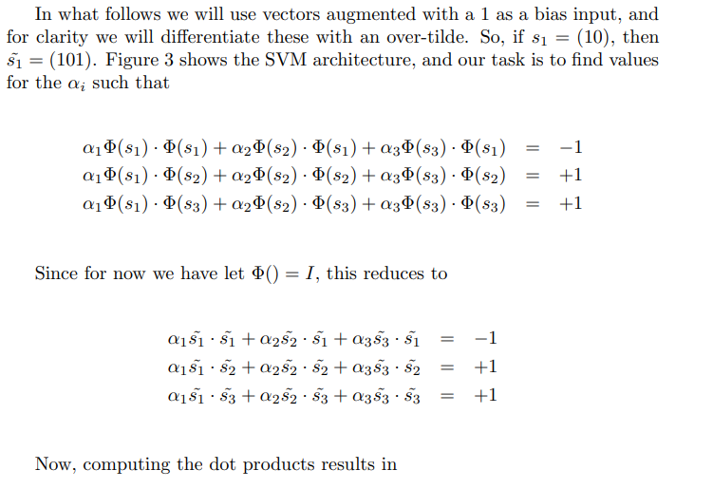

Slide 23
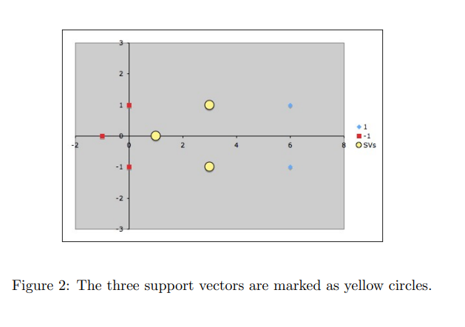
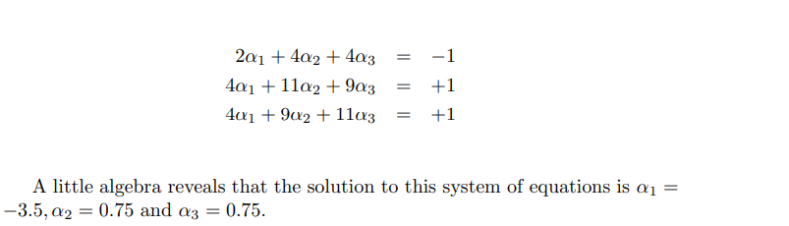
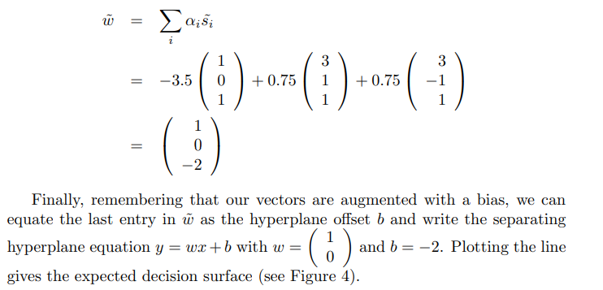
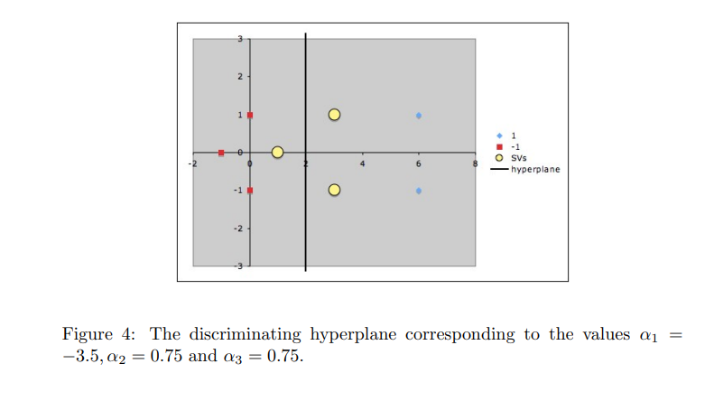

Slide 24








Non-linearly Separable Problems
We allow “error” ξ_{i} in classification; it is based on the output of the discriminant function w^{T}x+b
ξ_{i} approximates the number of misclassified samples
Class 2
Class 1

Slide 25
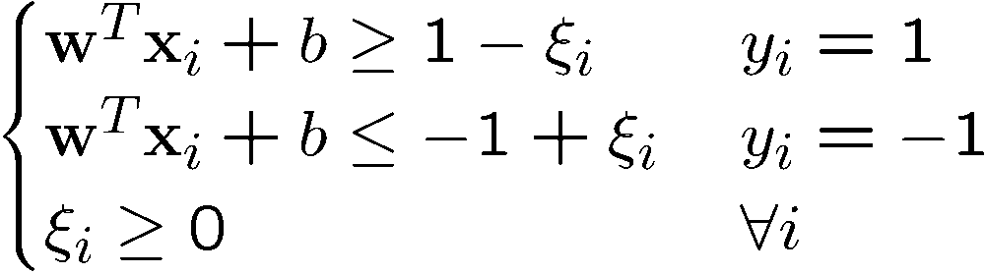
Soft Margin Hyperplane
The new conditions become
ξ_{i} are “slack variables” in optimization
Note that ξ_{i}=0 if there is no error for x_{i}
ξ_{i} is an upper bound of the number of errors
We want to minimize
C : tradeoff parameter between error and margin

Slide 26
The Optimization Problem
With α and μ Lagrange multipliers, POSITIVE
Notes:
Note also, everything is done by inner-products

Slide 27
The Dual Problem
With
Notes:
Note also, everything is done by inner-products

Slide 28
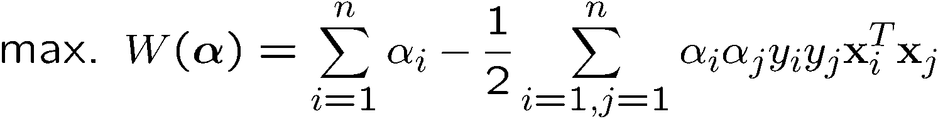
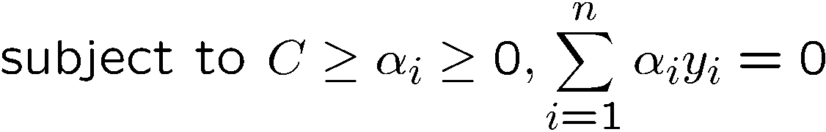
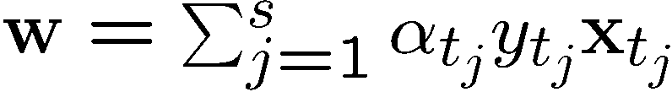
The Optimization Problem
The dual of this new constrained optimization problem is
New constrains derive from since μ and α are positive.
w is recovered as
This is very similar to the optimization problem in the linear separable case, except that there is an upper bound C on α_{i} now
Once again, a QP solver can be used to find α_{i}
Notes:
Note also, everything is done by inner-products

Slide 29
The algorithm try to keep ξ null, maximizing the margin
The algorithm does not minimize the number of error. Instead, it minimizes the sum of distances from the hyperplane
When C increases the number of errors tend to lower. At the limit of C tending to infinite, the solution tend to that given by the hard margin formulation, with 0 errors

Slide 30
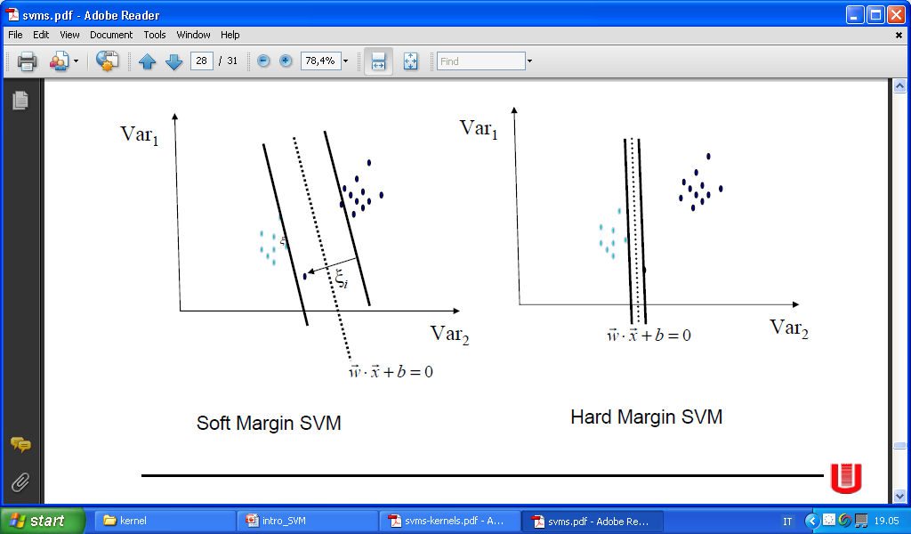
Soft margin is more robust

Slide 31
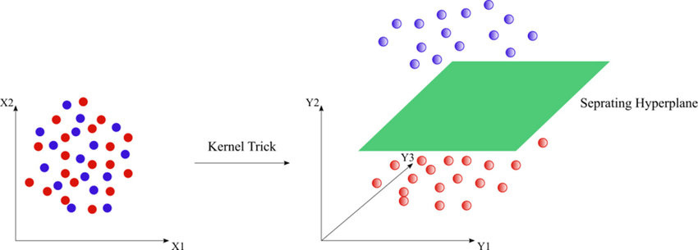
What if data is nonlinearly separable?
The maximal margin hyperplane can classify only linearly separable data
What if the data is linearly non-separable?
Transform your data into a higher-dimensional space to make it linearly separable, and then use a hyperplane that maximizes the margin

Slide 32
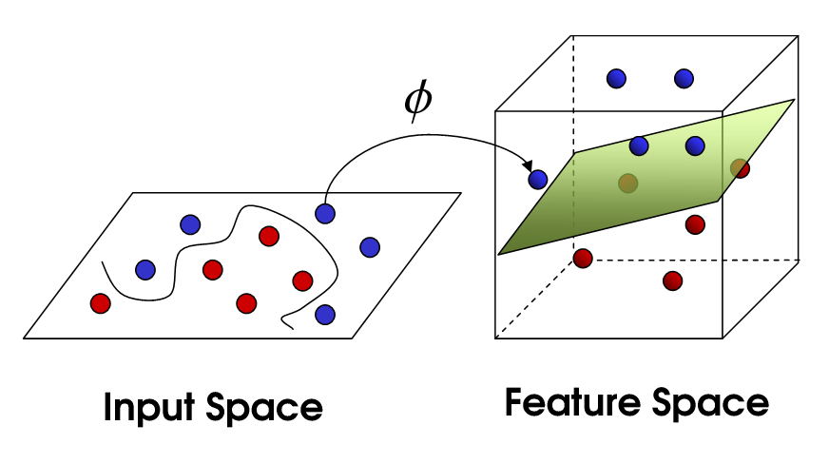
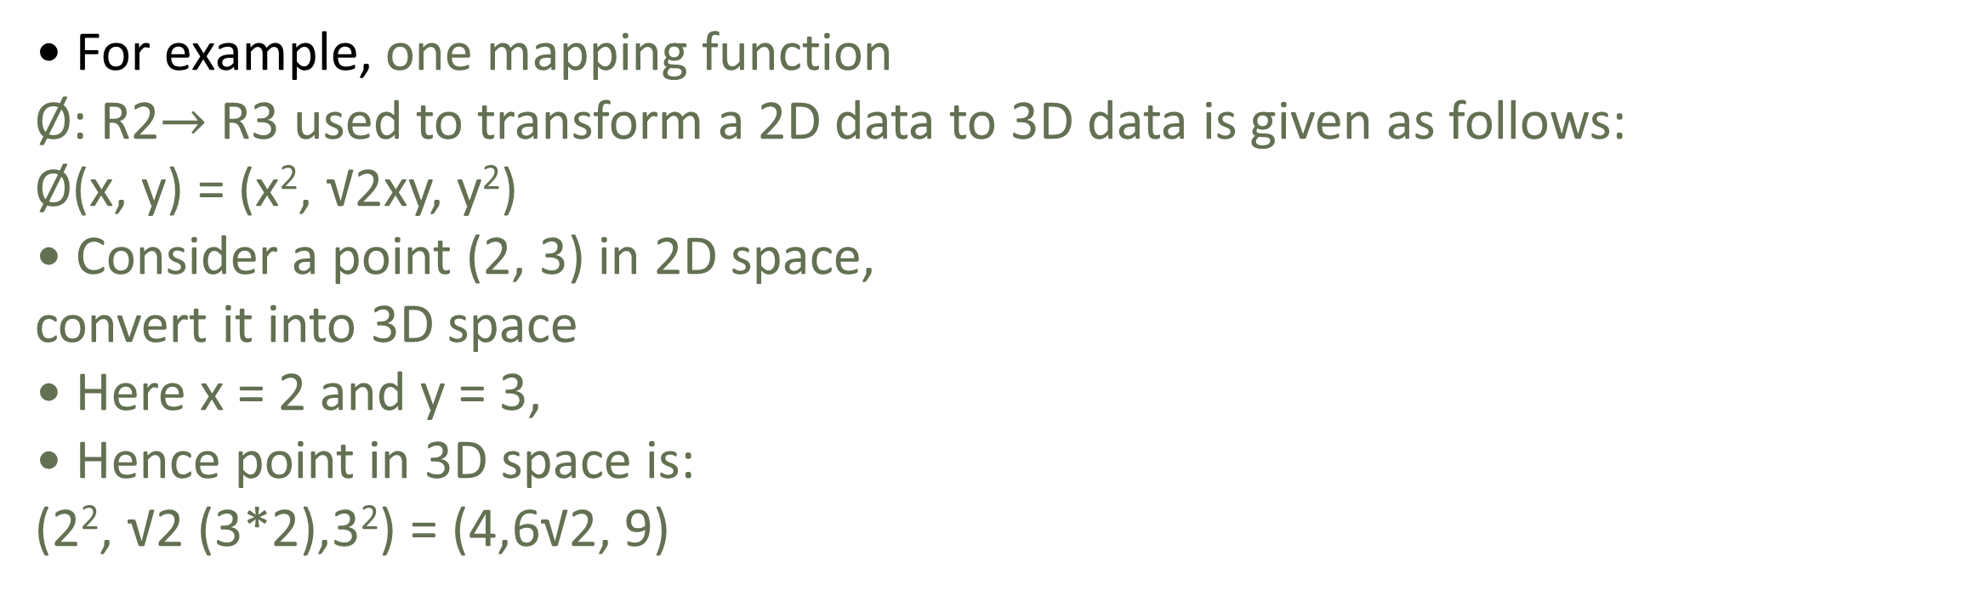
Non-linear data mapping
For non-linear data in SVM, we utilize a mapping function to transform the input space into a higher-dimensional feature space.
This transformation allows the SVM to identify a hyperplane that can effectively separate the data points in this new space, thereby enabling accurate classification despite the original data exhibiting complex, non-linear relationships
• For example, one mapping function
Ø: R2$→$ R3 used to transform a 2D data to 3D data is given as follows:
Ø(x, y) = (x², √2xy, y²)
• Consider a point (2, 3) in 2D space,
convert it into 3D space
• Here x = 2 and y = 3,
• Hence point in 3D space is:
(2², √2 (3*2),3²) = (4,6√2, 9)

Slide 33
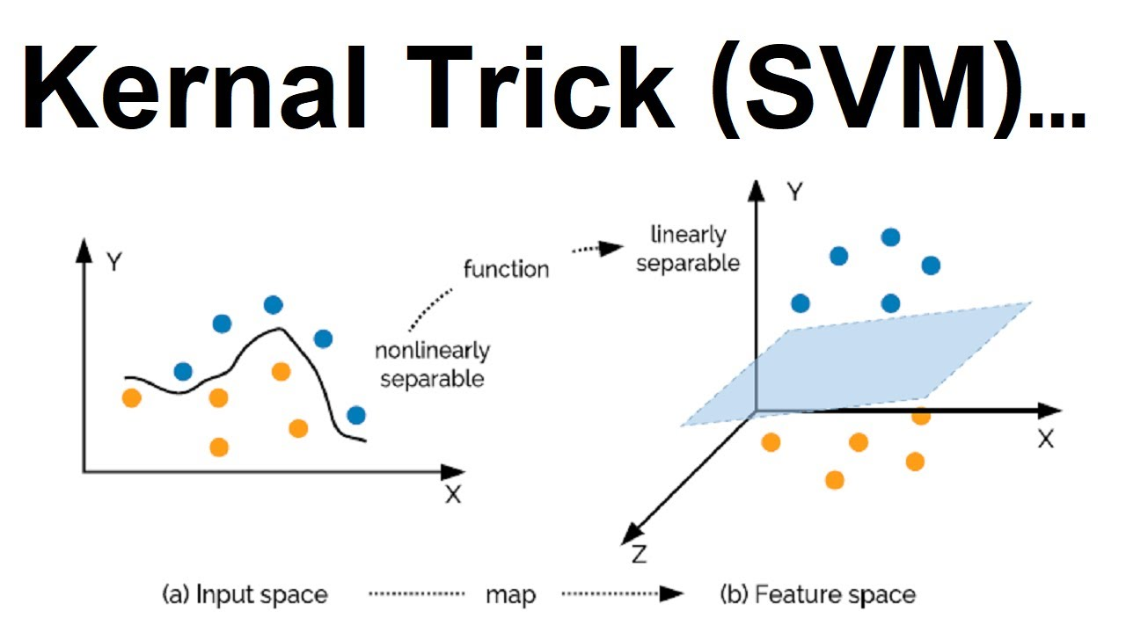
Mapping Functions and Challenges • Mapping involves more computations and learning costs. • No generalized rule for transformations. • Large data can slow down mapping process. • High computational costs due to polynomial combinations in complex data. Kernels are useful for computing values without transforming data.
What is a Kernel?
Kernels are a set of functions used to transform data from lower dimension to higher dimension and to manipulate data using dot product at higher dimensions.

Slide 34
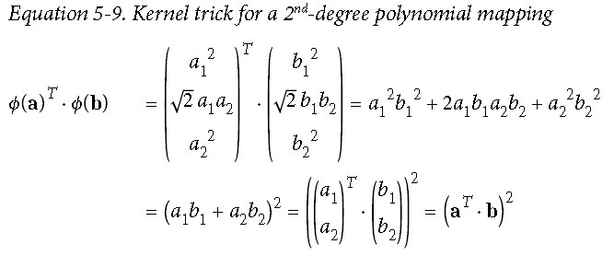
Kernel Function
Kernel function accepts inputs in the original lower dimensional space and returns the dot product of the transformed vectors in the higher dimensional space.
It can somewhat help to understand how the kernel function is equal to the dot product of the transformed vectors by considering that each coordinate of the transformed vector ϕ(x) is just some function of the coordinates in the corresponding lower dimensional vector x.
e.g., the kernel trick for the 2nd-degree polynomial is illustrated below

Slide 35
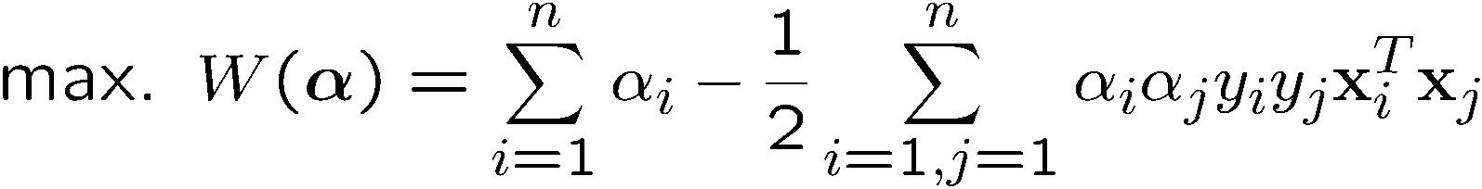

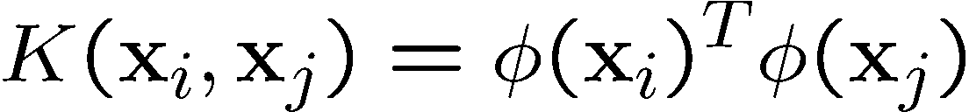
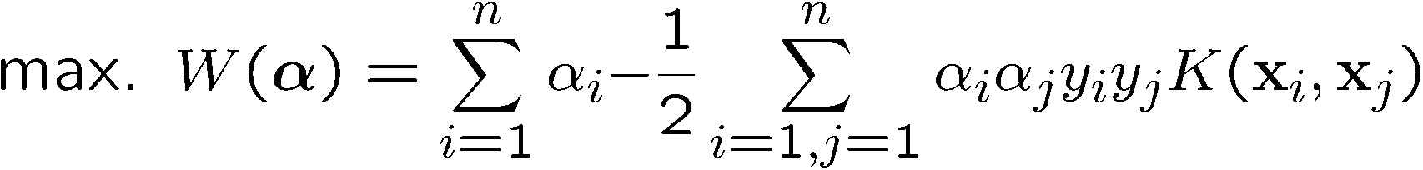
Modification Due to Kernel Function
Change all inner products to kernel functions
Original
With kernel function

Slide 36


Why do we need Kernel Trick
Kernel trick means replacing the dot product in mapping functions with a kernel function.
k(x, y) = Ø(x)·(y)
Similar to mapping functions, kernels help in mapping data from input space to higher-dimensional feature space with least computations.
Performing the kernel operation is much easier compared to mapping functions.
This is illustrated in the following numerical example.
Consider two data points (1, 2) and (3, 4)
Apply a polynomial kernel k(x, y) = (x^{T}y)² and show that it is equivalent to mapping function
Ø = (x², y², √2 xy)
Solution:
Ø(1, 2) = (1², 2², √2 (1 * 2)) = (1, 4, 2√2)
Ø(3, 4) = (3², 4², √2( 3 * 4)) = (9, 16, 12√2)
Ø(1,2).Ø(3, 4) = (1, 4, 2$\sqrt{2}$).(9,16,12 $\sqrt{2}$ ) = (1×9+4x16+24(2))= 121
Now, using polynomial kernel function, k(x, y) = (x^{T}y)², it can be computed as:
$${\left(\left(\begin{matrix}1 \\ 2\end{matrix}\right)⋅\left(3 4\right)\right)}^{2}={11}^{2}=121$$
It can be seen the computation involves many multiplication operations.
The operation can be computed quickly using kernel functions.

Slide 37




EXAMPLE
Suppose we have 5 1D data points
x₁=1, x₂=2, x₃=4, x₄=5, x₅=6,
1, 2, 6 as class 1 and 4, 5 as class 2
y₁=1, y₂=1, y₃=-1, y₄=-1, y₅=1
We use the polynomial kernel of degree 2
K(x,y) = (xy+1)²
C is set to 100
We first find a_{i} (i=1, …, 5) by
By using a QP solver, we get
$α$₁=0, $α$₂=2.5, $α$₃=0, $α$₄=7.333, $α$₅=4.833
Note that the constraints are indeed satisfied
The support vectors are {x₂=2, x₄=5, x₅=6}

Slide 38





The discriminant function is
b is recovered by solving f(2)=1 or by f(5)=-1 or by f(6)=1,
All three give b=9

Slide 39

Common Kernel Functions

Slide 40
Choosing the Kernel Function
Probably the most tricky part of using SVM
The kernel function is important because it creates the kernel matrix, which summarizes all the data
Many principles have been proposed (diffusion kernel, Fisher kernel, string kernel, …)
There is even research to estimate the kernel matrix from available information
In practice, a low degree polynomial kernel or RBF kernel with a reasonable width is a good initial try
Note that SVM with RBF kernel is closely related to RBF neural networks, with the centers of the radial basis functions automatically chosen for SVM

Slide 41
Advantages
Effective in high-dimensional spaces: SVMs perform well even with larger features than observations.
Resistant to overfitting: SVMs use the margin maximization principle to generalize well to unseen data.
Versatile: SVMs can be applied to both classification and regression problems, supporting different kernel functions.
Effective in limited data cases: SVMs work well even with small training data sets.
Ability to handle nonlinear data: SVMs use kernel functions to transform input into a higher-dimensional feature space, enabling linear decision boundaries.

Slide 42
Disadvantages
Computational Intensity: • SVMs can be computationally expensive, especially with large data sets. • Training time and memory requirements increase with the number of training samples.
Sensitive Parameter Tuning: • SVM performance can be sensitive to parameter settings like regularization parameter and kernel function choice.
Lack of Probabilistic Outputs: • SVMs provide binary classification outputs but do not directly estimate class probabilities. Difficulty in Interpreting Complex Models: • SVMs create complex decision boundaries, making it difficult to interpret and understand data patterns. Scalability Issues: • SVMs may face scalability issues when applied to large data sets.

Slide 43
THANK YOU

